Slide 1

HIGH CLOUD AIRLINES
DATA ANALYSIS
PROJECT
Modules: Excel, SQL, Power BI, Tableau
Group – 1
Thanuj
Sravan
Yogesh
Puneeth
Ganesh
Soharab Shaikh

Slide 2
CONTENTS
Introduction
Objective
Business Overview
Project Scope
Data Model Challenges
KPI’s Analysis
Dashboards
Recommendations
Conclusion

Slide 3

INTRODUCTION
High Cloud Airline is a leading organization in the aviation industry, focused on delivering efficient and reliable air travel experiences through data-driven decision-making.
The company emphasizes operational excellence, safety, and customer satisfaction, consistently meeting industry standards.
With an extensive network of routes across multiple regions, High Cloud connects people and cultures worldwide.
By leveraging modern technology and analytics, the airline continuously improves operational efficiency and enhances passenger experience.

Slide 4
OBJECTIVE
To gain a comprehensive understanding of "High Cloud Airlines" operations through data analysis. This will involve investigating load factors, identifying top carrier names based on passenger preference, analyzing popular routes, and exploring other key metrics. The ultimate goal is to provide actionable recommendations that can enhance operational efficiency and profitability.

Slide 5
BUSINESS OVERVIEW
Project Overview: In today’s competitive airline industry, data analysis plays a critical role in optimizing operations and maximizing profitability. By harnessing the power of data, High Cloud Airlines can gain valuable insights into various aspects of its business, allowing them to make data-driven decisions that can lead to Improved load factor Enhance Passenger Experience Optimized resource allocation Data –Driven Decision Making

Slide 6
PROJECT SCOPE
The Project aimed to leverage the power of data analysis and extract valuable insights to optimize high cloud airline operations and performance. The specific scope of the project focused on analyzing key performance indicators (KPIs) to gain deeper understanding of
Load Factor
Passenger Preferences
Popular Routes
Operational Efficiency.

Slide 7
DATA MODEL CHALLENGES
Throughout our analysis, we encountered various challenges in handling the data. Overcoming these challenges is crucial for accurate insights.
Data Volume: Managing and Processing large datasets efficiently.
Data Quality: Ensuring accuracy and reliability of the data.
Complex Relationships: Establishing connections between different data points of the data.
Errors and Duplicates: Cleaning data to fix incorrect values and remove duplicates.
Data Merging: For Extracting Different kpi's we need to merge the datasets with the help of power query.
Outliers: Flagging and handling unusual data for accuracy.

Slide 8

KPI’s Analysis

Slide 9
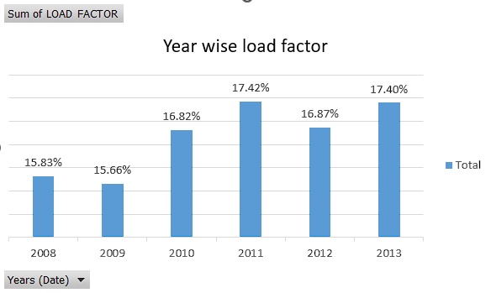
Load Factor Percentage on a Yearly
Load Factor indicates the percentage of available seats filled by passengers and reflects airline efficiency.
From 2008 to 2009, the load factor remained stable at around 15.8%, showing consistent demand.
A clear improvement started in 2010, increasing to 16.82%, and reached its peak in 2011 at 17.42%, indicating better seat utilization and higher passenger demand.
In 2012, there was a minor dip to 16.87%, suggesting a temporary slowdown.
The airline quickly recovered in 2013, reaching 17.40%, showing stability and sustained performance.

Slide 10
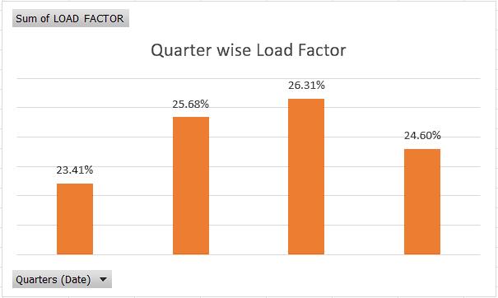
Load Factor Percentage on a Quarterly
The quarterly load factor analysis shows how seat occupancy varies across different quarters.
Q1 recorded the lowest load factor at 23.41%, indicating relatively lower passenger demand.
A significant improvement is observed in Q2, where the load factor increased to 25.68%, reflecting higher travel activity.
The highest load factor is in Q3 at 26.31%, showing peak passenger demand and optimal seat utilization.
In Q4, the load factor slightly declined to 24.60%, but remained higher than Q1, indicating stable performance.

Slide 11
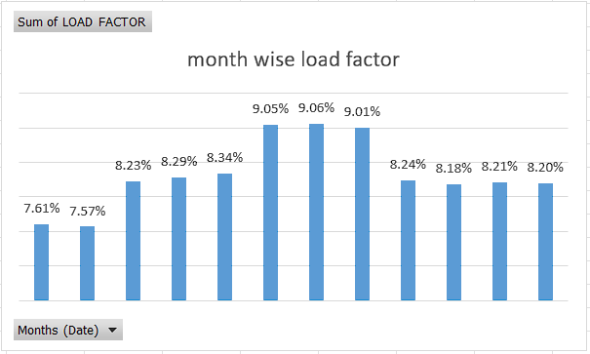
Load Factor Percentage on a Monthly
The monthly load factor analysis shows variations in seat occupancy across different months.
The lowest load factor is observed in the early months, with January (7.61%) and February (7.57%), indicating lower passenger demand.
From March to May, the load factor gradually increases.
Peak performance is seen during June (9.05%), July (9.06%), and August (9.01%), reflecting highest passenger demand and optimal seat utilization.
After August, the load factor slightly declines from September to December, remaining stable around 8.18%–8.24%.

Slide 12
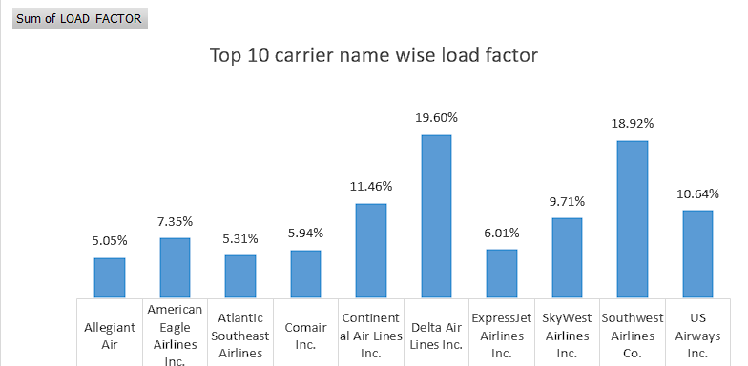
Load Factor Percentage on a Carrier Name Basis
Delta Air Lines Inc. leads with the highest load factor of 19.60%,
showing strong passenger traffic and efficient capacity utilization across its routes.
Southwest Airlines Co. follows closely with 18.92%,
indicating a consistently high demand and reflecting the carrier’s strong market presence.
Continental Air Lines Inc. (11.46%) and US Airways Inc. (10.64%)
maintain mid-range performance, while airlines like Allegiant Air (5.05%) and Atlantic Southeast Airlines (5.31%) occupy the lower end of the top 10.

Slide 13
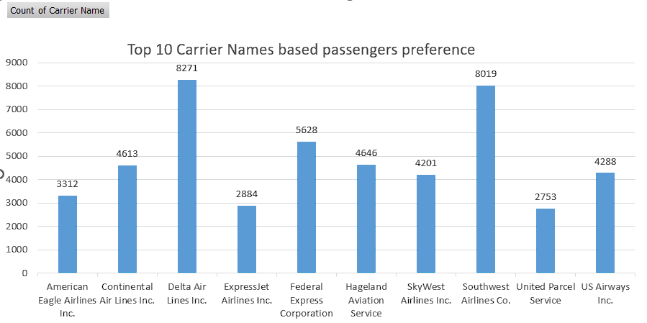
Top 10 Carrier Names Based on Passengers Preference
Delta Air Lines Inc. has the highest passenger count of 8271, making it the most preferred airline among the top 10 carriers shown. This indicates strong customer demand and route popularity.
Southwest Airlines Co. follows closely with 8019 passengers, showing it is nearly as popular as Delta Air Lines Inc. and remains one of the top choices for travelers.
There is a large disparity between the top and bottom carriers. Delta Air Lines Inc. leads by a significant margin, having nearly 3× more passengers than several lower-ranked airlines. This clearly shows a concentration of passenger preference toward the top two carriers.

Slide 14
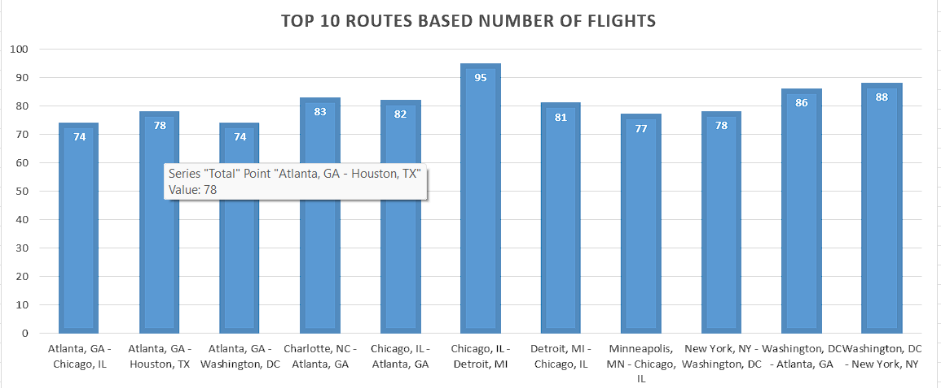
Display Top 10 Routes Based on Number of Flight
This bar chart highlights the top 10 most frequently flown routes, ranked based on the total number of flights operated between city pairs.
The most popular route is Chicago, IL → Detroit, MI with 95 flights, showing a strong travel connection between these two major cities and making it the highest-frequency route among the top 10.
The data suggests that major U.S. cities like Chicago, Atlanta, Washington DC, and New York dominate the air travel network, forming highly active flight corridors across the country.

Slide 15
Load Factor is occupied on Weekend vs Weekdays.
The pie chart shows that the load factor is occupied on Weekdays 71.18% of the time and on Weekends 28.82% of the time.
This suggests that the load factor is more heavily used during the week, possibly due to factors such as business hours or school schedules.
It is worth noting that the Weekday load factor is more than double the Weekend load factor. Further investigation could be conducted to determine the reason for this disparity.
This could include an analysis of the specific hours during the week and weekend when the load factor is being used, as well as any seasonal or cyclical patterns that might be present.

Slide 16
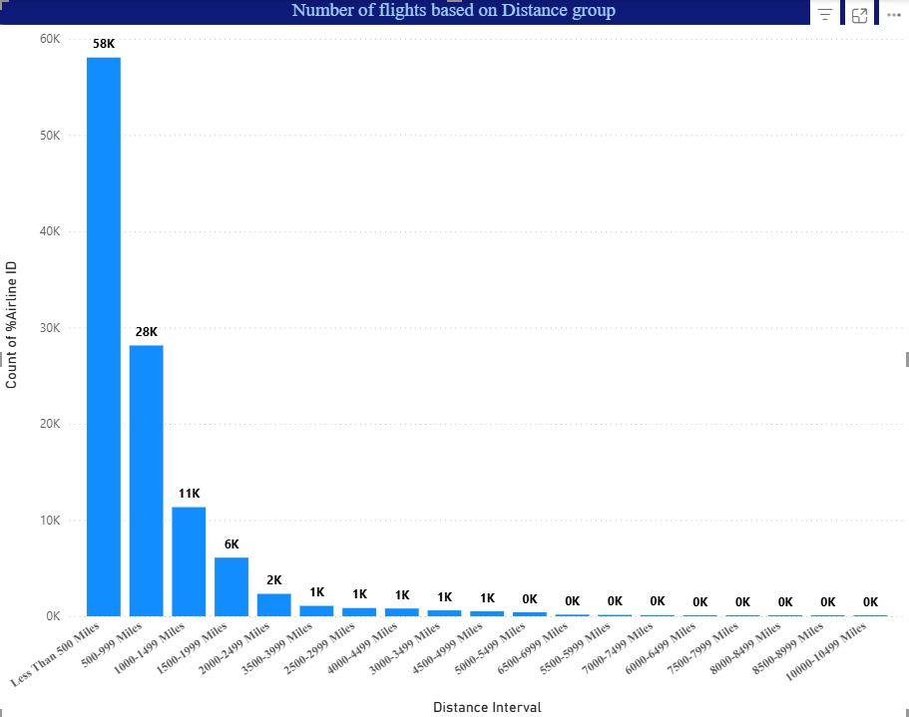
Identify number of flights based on Distance group
This KPI shows the number of flights based on distance group. We can see that the number of flights decreases as the distance increases. This is likely because:
Shorter flights are more common: People are more likely to take shorter flights for business trips, leisure travel, or visiting family and friends.
Cost: Longer flights are more expensive, both for airlines and passengers.
Time: Longer flights take more time, which can be a deterrent for some travelers.
The data also shows that the number of flights drops off sharply after 1,000 miles, and continues to decline at a more gradual rate. This suggests that there are more factors at play than just the distance itself. For example, there may be fewer destinations that are further away, or there may be more competition from other transportation modes such as trains or buses.
Overall, this data provides insights into the travel patterns of people, and how these patterns are influenced by factors such as distance, cost, and time.

Slide 17

DASHBOARDS

Slide 18
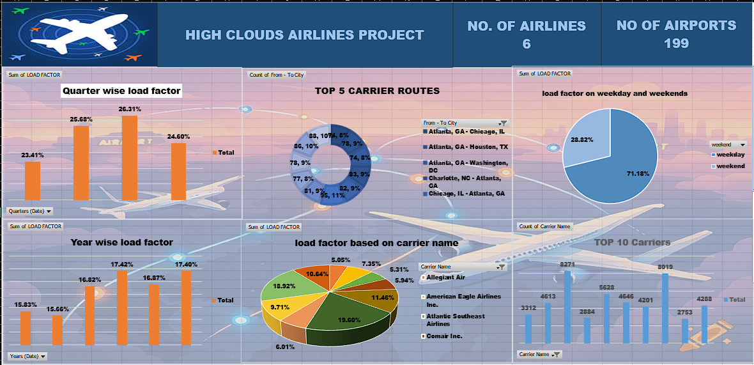
EXCEL DASHBOARD

Slide 19
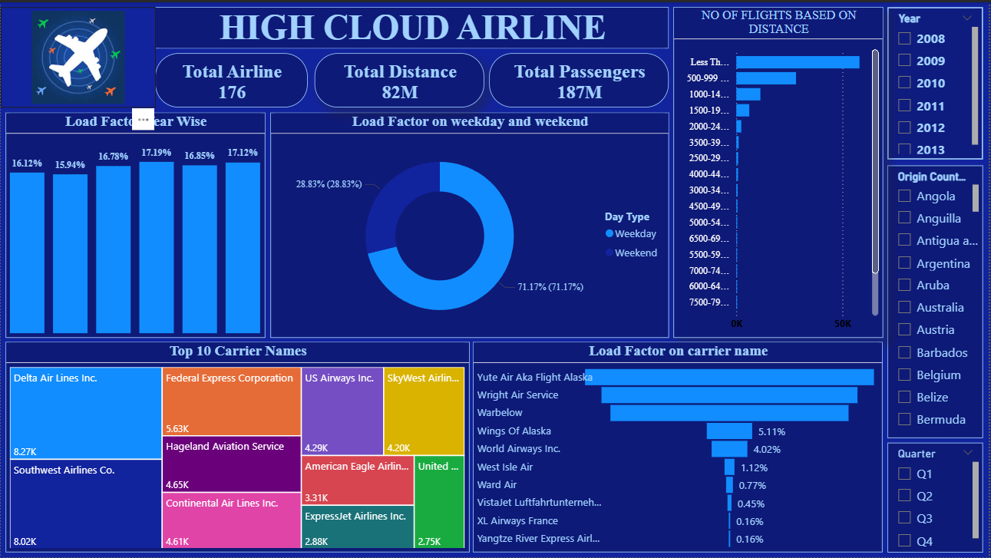
POWER BI DASHBOARD

Slide 20
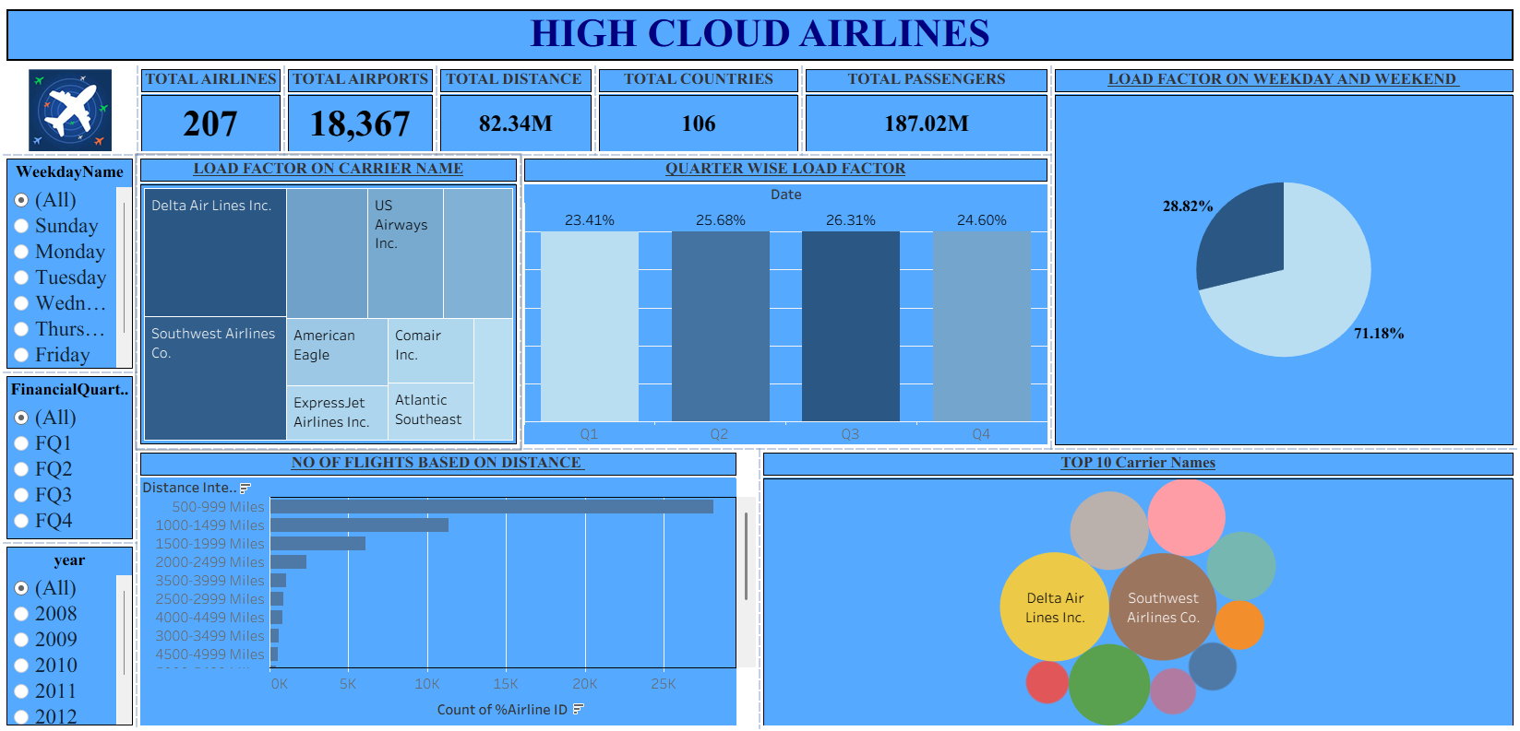
TABLEAU DASHBOARD

Slide 21
KEY INSIGHTS
Optimize Fight Routes: Utilize insight from up routes and flights to Optimize schedule and resource allocation.
Enhance Load Factor: Average load factor analysis to identify trends and implement strategies for increased efficiency.
Stratergic Carrier Partnership: Collaborate with top carriers to maximize passenger transportation and enhance overall performance.
Resourse Allocation: Allocate resources strategically based on flight schedules and passenger volume data.

Slide 22
RECOMMENDATIONS
Optimize Fight Routes: Utilize insights from up routes and flights to Optimize schedule and resource allocation.
Enhance Load Factor: Leverage load factor analysis to identify trends and implement strategies for increased efficiency.
Stratergic Carrier Partnership: Collaborate with top carriers to maximize passenger transportation and enhance overall performance.
Resourse Allocation: Allocate resources strategically based on flight schedules and passenger volume data. This ensures efficient operation and minimizes wait times at airports with high passenger traffic

Slide 23
CONCLUSION
High Cloud Airlines empowers the aviation industry with actionable insights, foresting efficiency, and strategic decision-making. The presented KPIs offer a glimpse into the vast potential for improvement and growth within the industry. By harnessing the power of data, we can drive positive changes, ensuring a bright future for High Cloud Airlines and its partners in the aviation sector.

Slide 24


